Slide 1
MULTIPLE BREAK REBAR
Advisor : Prof. K.C.Chang
Presenters : You-Ran Nai

Slide 2
Incremental dynamic analysis
Dimitrios Vamvatsikos and C. Allin Cornell
EARTHQUAKE ENGINEERING AND STRUCTURAL DYNAMICS
2002
Notes:
Department of Civil and Environmental Engineering; Stanford University; CA 94305-4020; U.S.A.

Slide 3
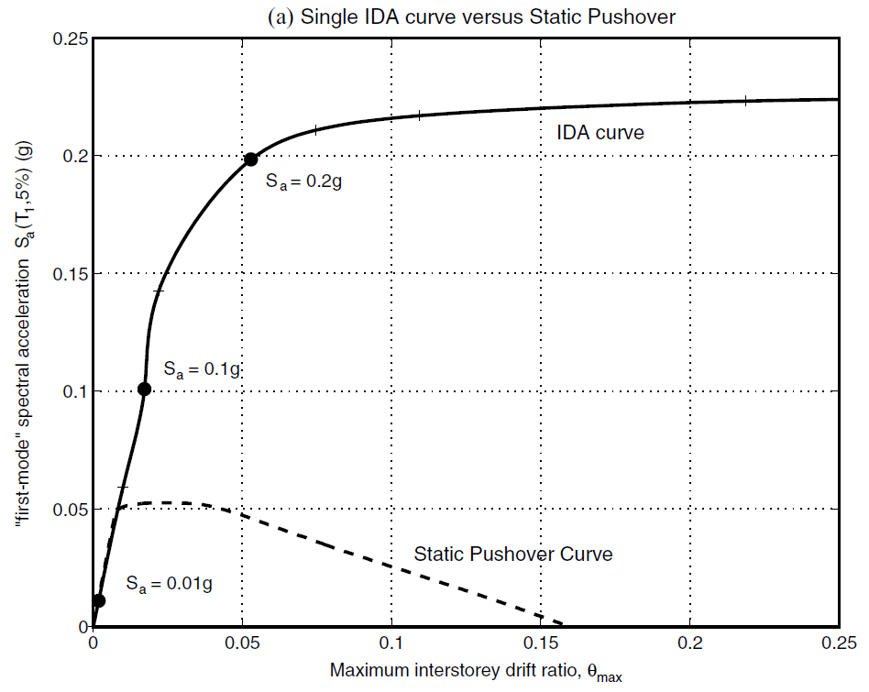
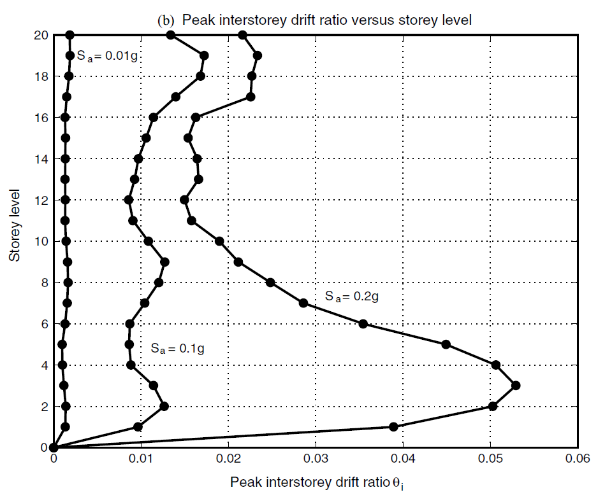
INTRODUCTION
SINGLE STATIC ANALYSIS
➔
INCREMENTAL SPO
SINGLE TIME-HISTORY ANALYSIS
➔
INCREMENTAL ONE

Slide 4
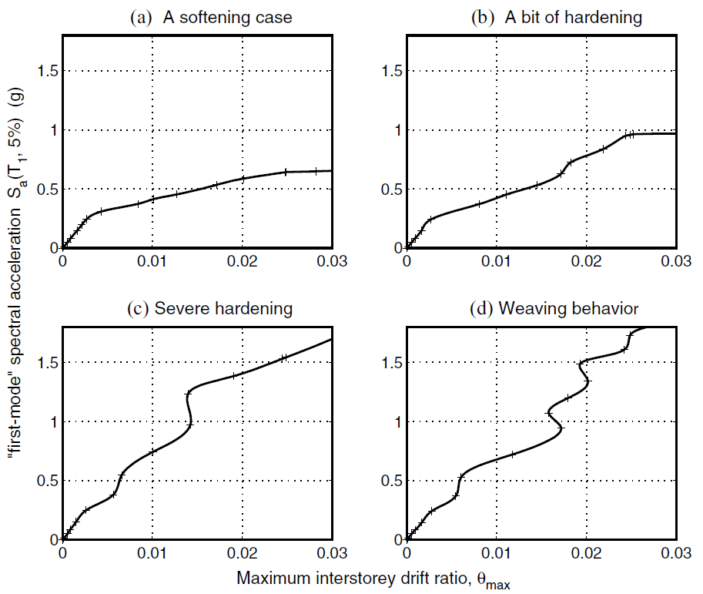
INFINITY
0.2g
SOFTENS
？
SOFTENING & HARDENING
EQUAL DISPLACEMENT
0.2g
Notes:
SOME GENERAL PROPERTIES

Slide 5
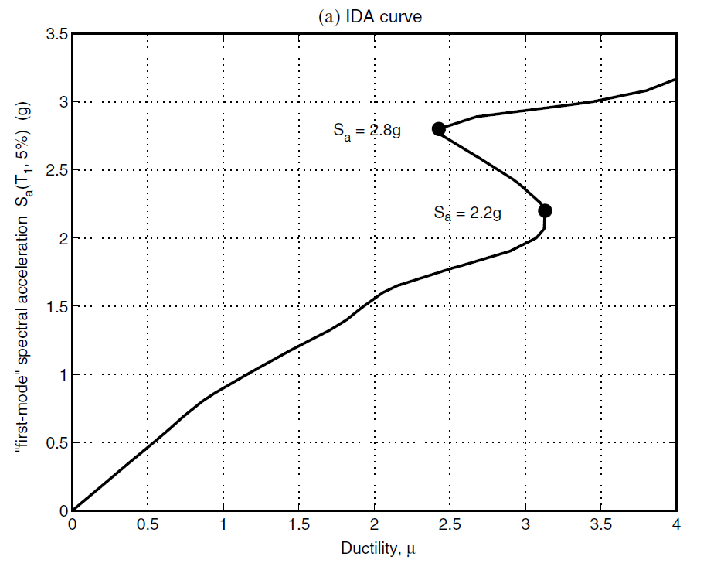
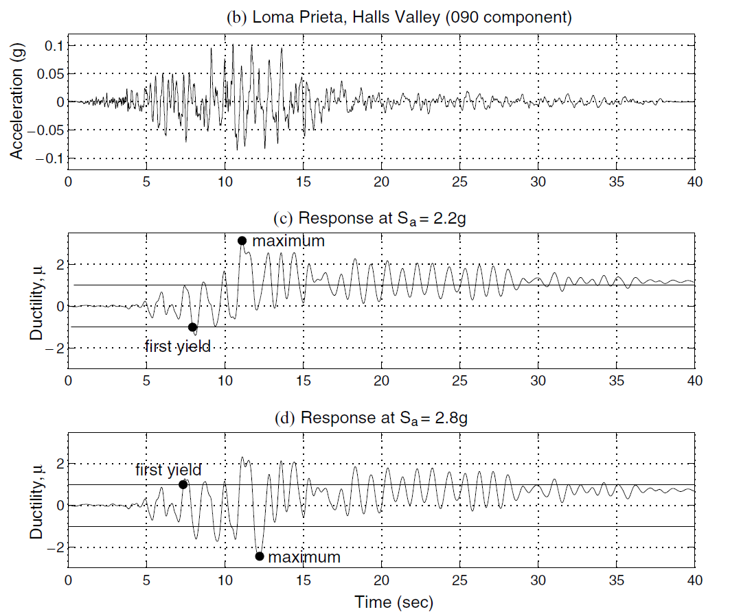
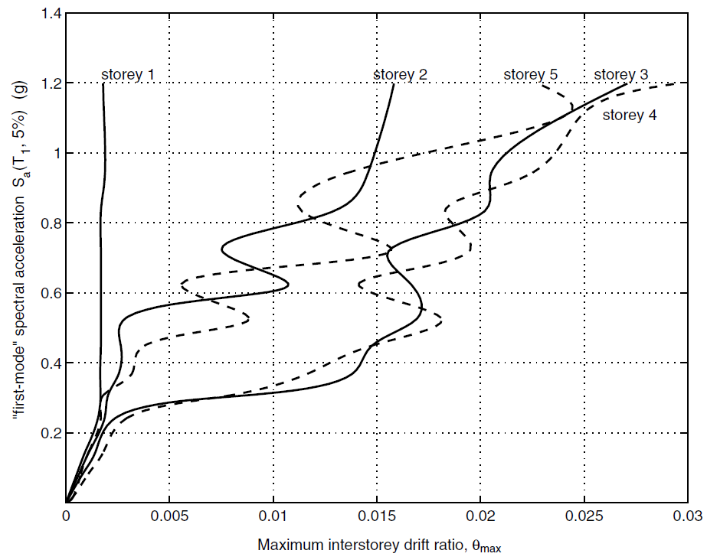
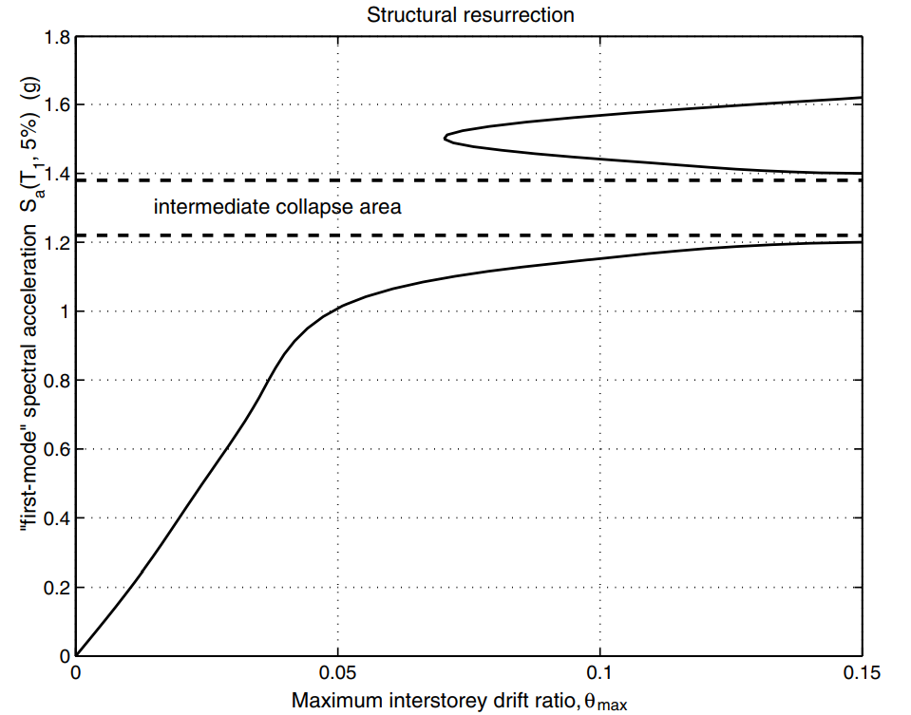
EARLIER YIELDING
FUSE
STRUCTURAL RESURRECTION

Slide 6
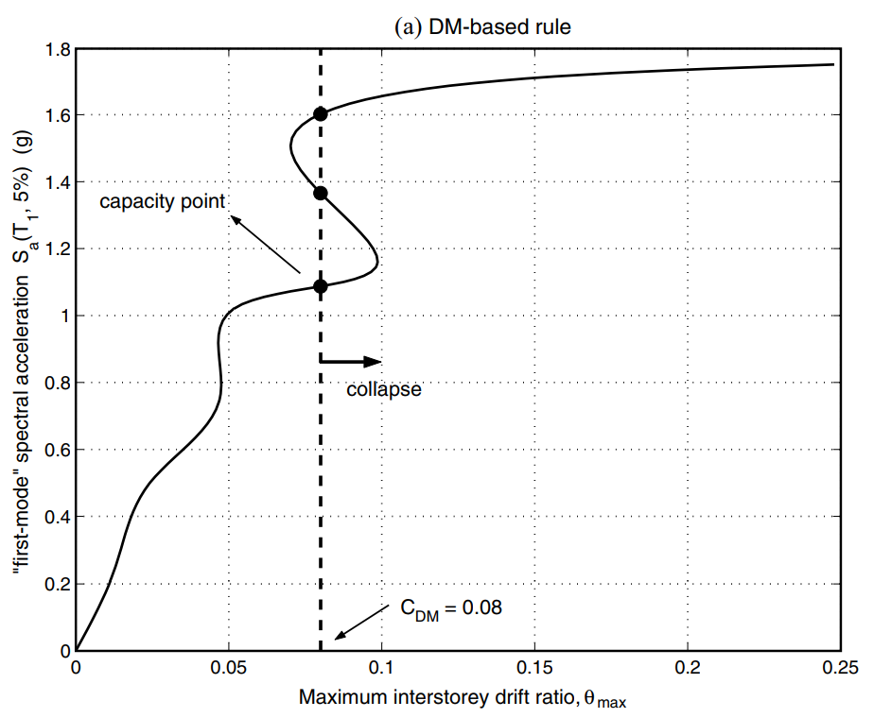
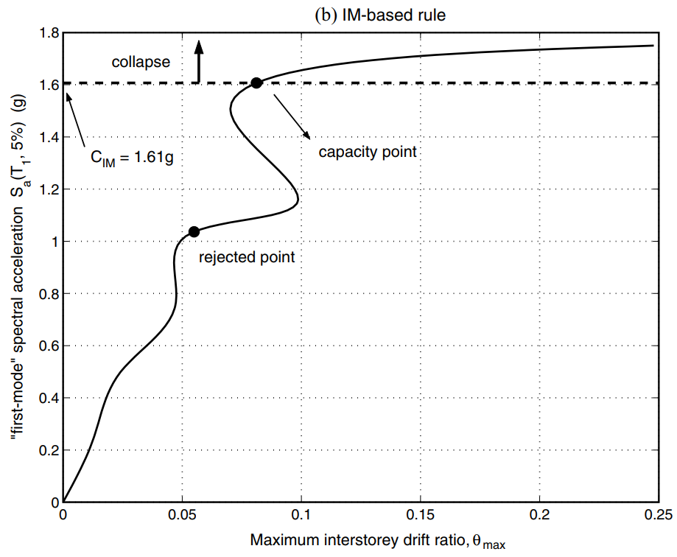
CAPACITY AND LIMIT-STATES
FEMA 20% TANGENT SLOPE APPROACH
Notes:
CAPACITY AND LIMIT-STATES

Slide 7
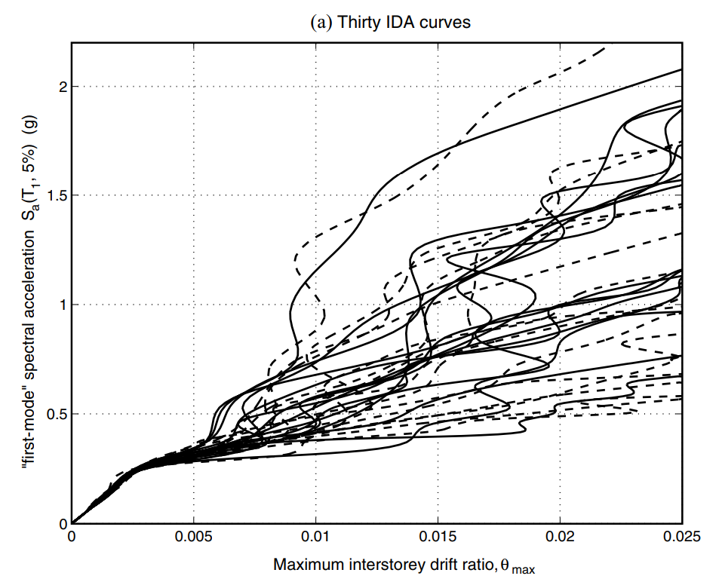


PARAMETRIC METHODS
NON-PARAMETRIC METHODS
CAPACITY

Slide 8
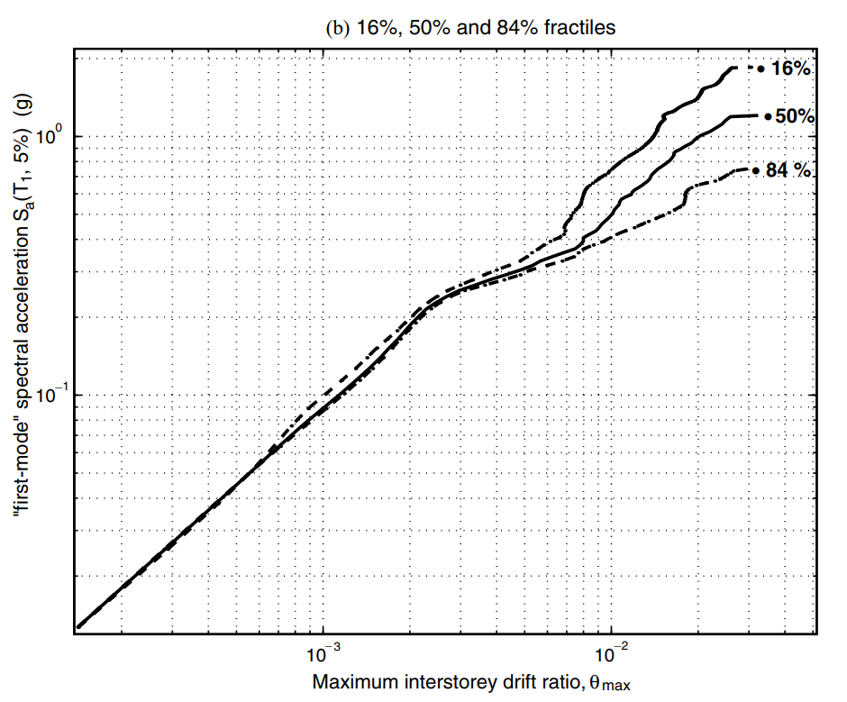

Slide 9


Slide 10
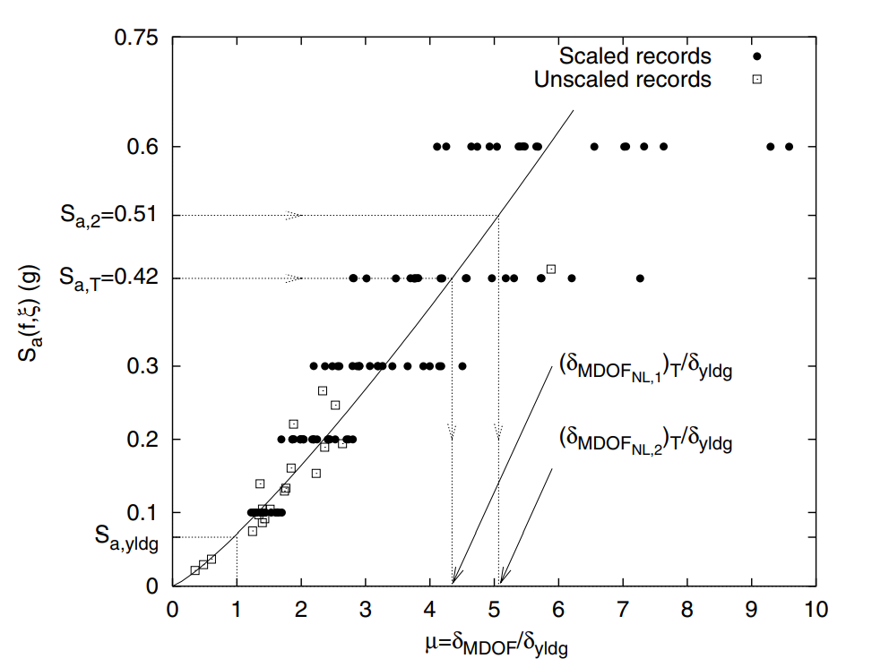

Slide 11
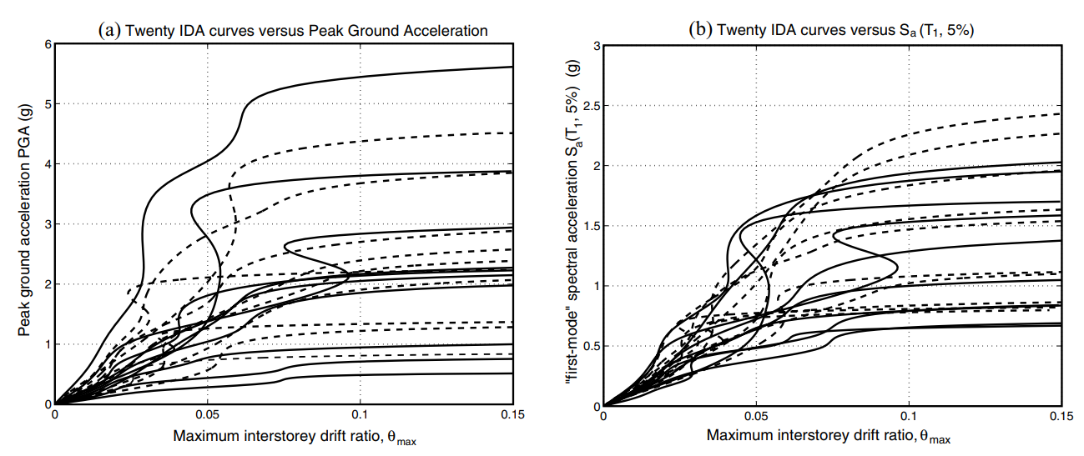

Slide 13
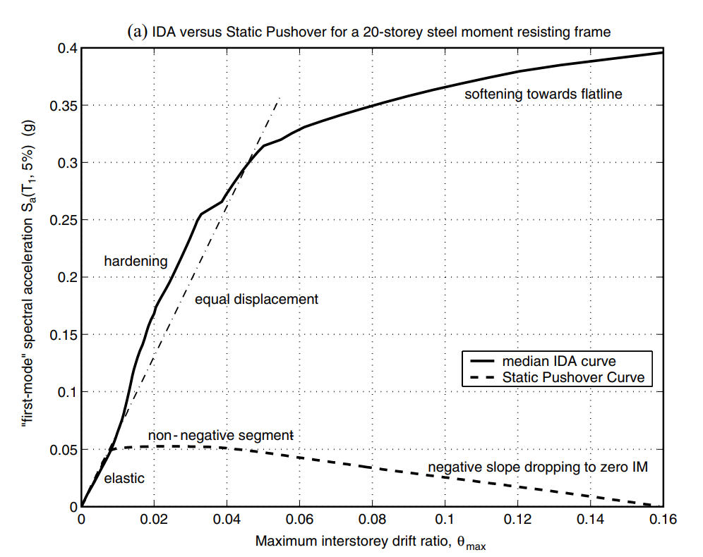

Slide 14
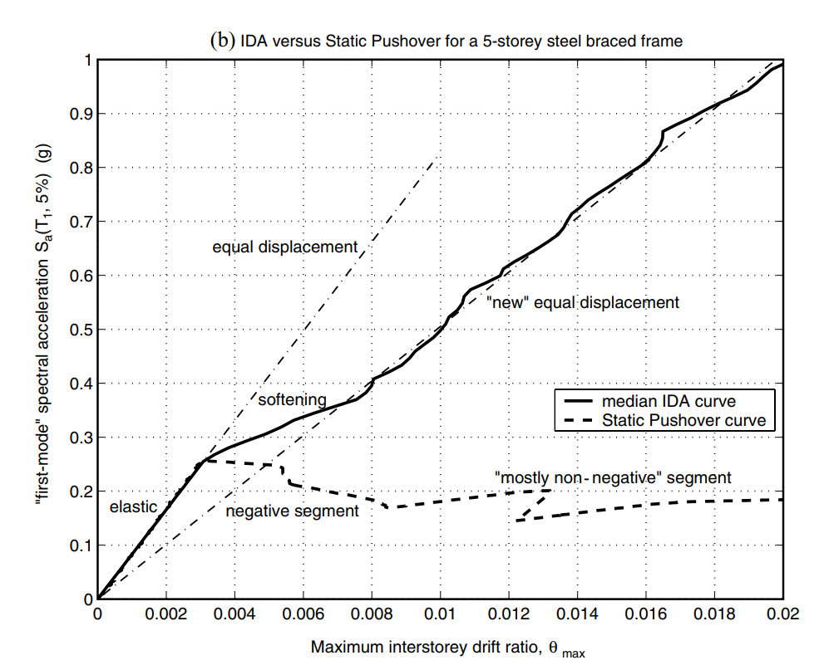

Slide 15

The problem you want to solve

Slide 16



Today’s solutions

Slide 17
Why it doesn’t work
Difficult to implement
Expensive for small businesses
Zero customization

Slide 18

Your solution

Slide 20
Your solution

Slide 21
Your solution

Slide 22
Your solution

Slide 24
Your solution

Slide 25
Awesome features
Awesome map feature
Awesome like feature
Awesome battery feature

Slide 26
Use case
1
2
3
4
5
Very Easy Step 1
Very Easy Step 2
Very Easy Step 3
Very Easy Step 4
Very Easy Step 5

Slide 27
Value Proposal
Make things really change
Make the world a better place
Offer one perfect answer
This is how we are going to make this happen in a beautiful way.
This is how we are going to make this happen in a beautiful way.
This is how we are going to make this happen in a beautiful way.

Slide 28
Market Sizing
$36b
$12b
$2b
Total World Market
Total US Market
Total FR Market
Source : source.io
Source : source.io
Source : source.io

Slide 29
Market Size over Time
Market Sizing (in €billions)

Slide 30
Market on Map
$1b
$2b

Slide 31
Why Now ?
Mobile Internet Usage

Slide 32


Customer Profiles
Young adults
25-35 years old
Students
15-20 years old

Slide 33
Competitors

Slide 34
AXIS 2
Your company
competitor
competitor
AXIS 1
AXIS 1
competitor
competitor
competitor
competitor
AXIS 2

Slide 35
 | YOUR COMPANY | COMPETITOR 1 | COMPETITOR 2 | COMPETITOR 3
feature 1
feature 2
feature 3
feature 4
feature 5
feature 6

Slide 36
Metrics
800
97%
94%
Paying users
Margin
Recurring users
$150,000
85,000
54
Monthly Recurring
Revenue
Users growing 45% per month
API Integrations

Slide 37
Conversion Rate
0,27%

Slide 38
Split Budget

Slide 39
Split Budget
75%
69%
30%
29%
29%
Marketing
Research
Sales
Design
Hiring

Slide 40
Forecast

Slide 41
Financial Table
 | 2016 | 2017 | 2018 | 2019 | 2020
Sales | 0 | 50 | 400 | 1000 | 3000
Revenue | - | $100 000 | $800 000 | $2 000 000 | $6 000 000
Gross Margin (%) | - | 49% | 51% | 53% | 58%
Expenses | - | $128 000 | $450 000 | $800 000 | $1 200 000
Net Profit | - | $-28,000 | $350 000 | $1 200 000 | $4 800 000
Profit Margin (%) | - | -28% | 44% | 60% | 80%

Slide 42
Outstanding Founders
Dave Lopper CTO
Come Mertial CEO
Tran Zition
CPO
Google
Facebook
Stanford
Microsoft
SalesForce
HEC Paris
Uber
Awwwards
MIT Media Lab

Slide 43
Advisors and Directors
Jérémy Vestiaire
Financial Advisor
Goldman Sachs
Jey Bestelgram
Product Advisor
Amazon
Oudam Dadam
Machine Learning Enthousiast
SpaceX
Tomy Lamousse
PR Advisor
Mashable
Lam Ontarelle
UX Contributor
Slidor
Renaude Yorella
Board Member
Sequoia Capital
Laurence Marc
Board Member
Accel Partners
Vince Lacluze
UI Director
Snapchat

Slide 44
Roadmap
02/2016
04/2016
06/2016
Market Overview
Pre-Release
Launch
01/2016
03/2016
05/2016
Introduction
Partnerships
Beta

Slide 45
Say you want to make the world a better place

Slide 46
Icons

Slide 47
Icons

Slide 48
Social

Slide 49
Red
Pink
Purple
Deep Purple
Indigo
Blue
Light Blue
Cyan
Teal
Green
Light Green
Lime
Yellow
Amber
Orange
Deep Orange
50
50
50
50
50
50
50
50
50
50
50
50
50
50
50
50
100
100
100
100
100
100
100
100
100
100
100
100
100
100
100
100
200
200
200
200
200
200
200
200
200
200
200
200
200
200
200
200
300
300
300
300
300
300
300
300
300
300
300
300
300
300
300
300
400
400
400
400
400
400
400
400
400
400
400
400
400
400
400
400
500
500
500
500
500
500
500
500
500
500
500
500
500
500
500
500
600
600
600
600
600
600
600
600
600
600
600
600
600
600
600
600
700
700
700
700
700
700
700
700
700
700
700
700
700
700
700
700
800
800
800
800
800
800
800
800
800
800
800
800
800
800
800
800
900
900
900
900
900
900
900
900
900
900
900
900
900
900
900
900
A100
A100
A100
A100
A100
A100
A100
A100
A100
A100
A100
A100
A100
A100
A100
A100
A200
A200
A200
A200
A200
A200
A200
A200
A200
A200
A200
A200
A200
A200
A200
A200
A400
A400
A400
A400
A400
A400
A400
A400
A400
A400
A400
A400
A400
A400
A400
A400
A700
A700
A700
A700
A700
A700
A700
A700
A700
A700
A700
A700
A700
A700
A700
A700

Slide 50
Gradient 1

Slide 51
Gradient 2

Slide 52
Gradient 3

Slide 53
Gradient 4

Slide 54
Gradient 5

